Slide 1
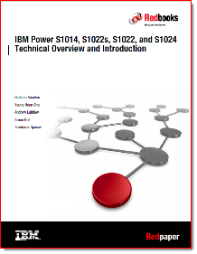
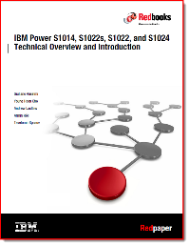
Power10 Systems presented as “Infographics”
IBM Power10
Redbooks
Version: 5 Sept 2022 Not IBM Official Content, Nigel Griffiths, IBM UK nag@uk.ibm.com YouTube: https://www.youtube.com/user/nigelargriffiths

Slide 2
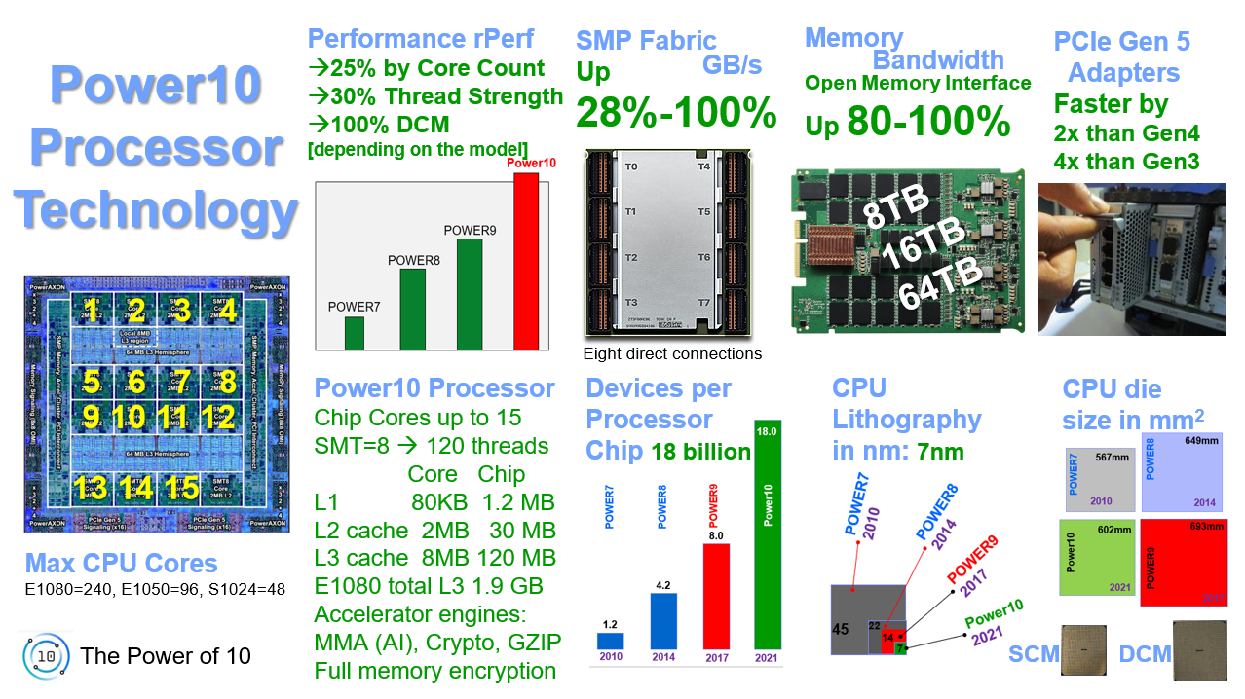
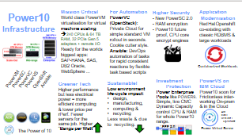
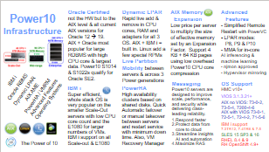
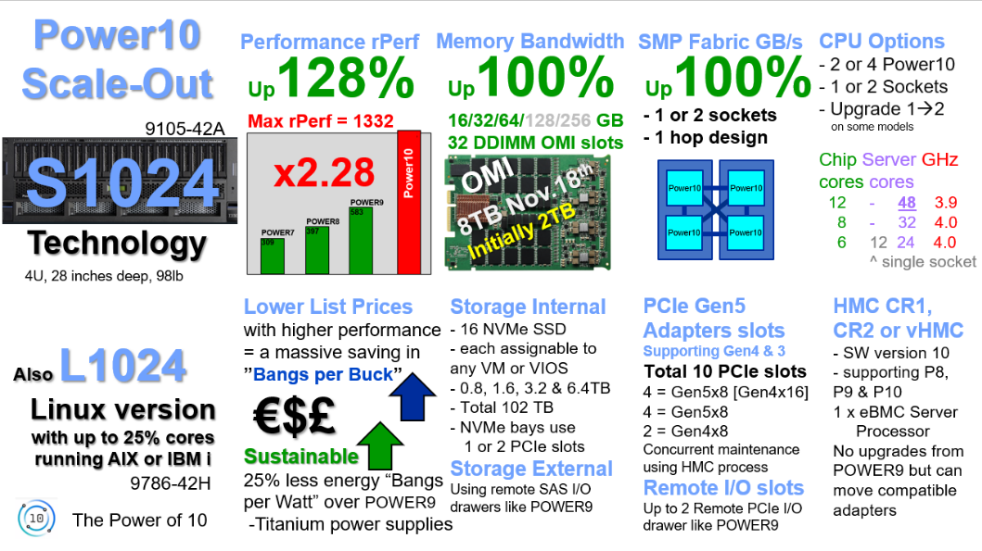
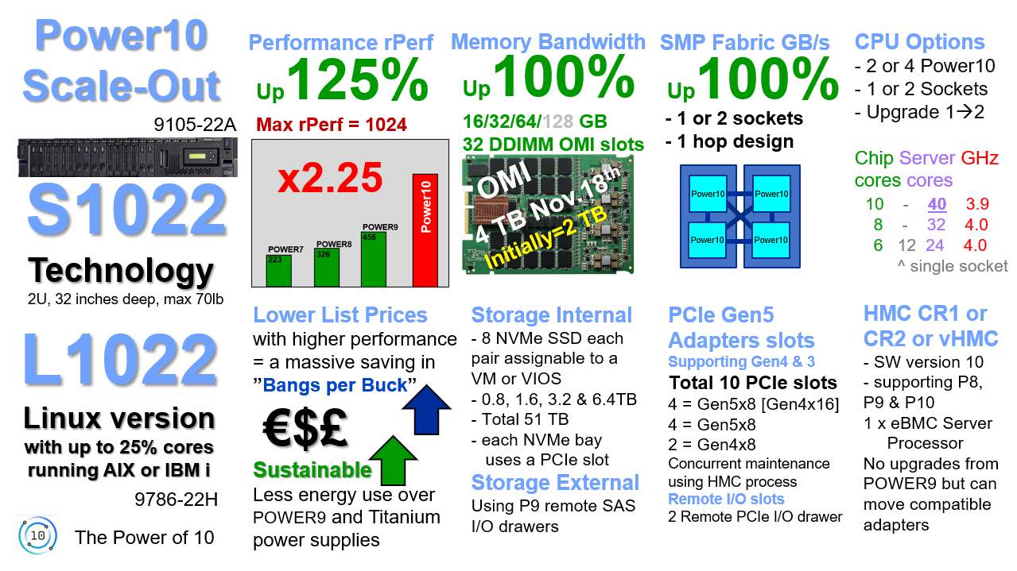
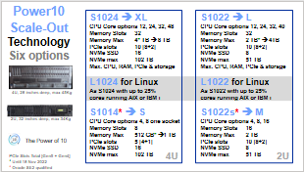
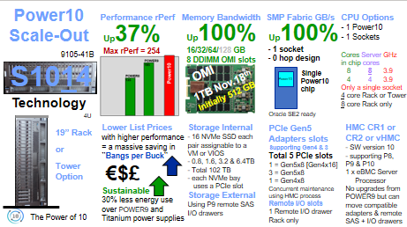
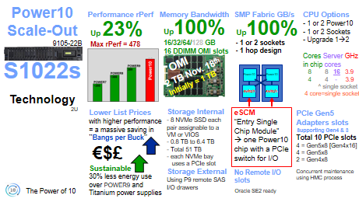
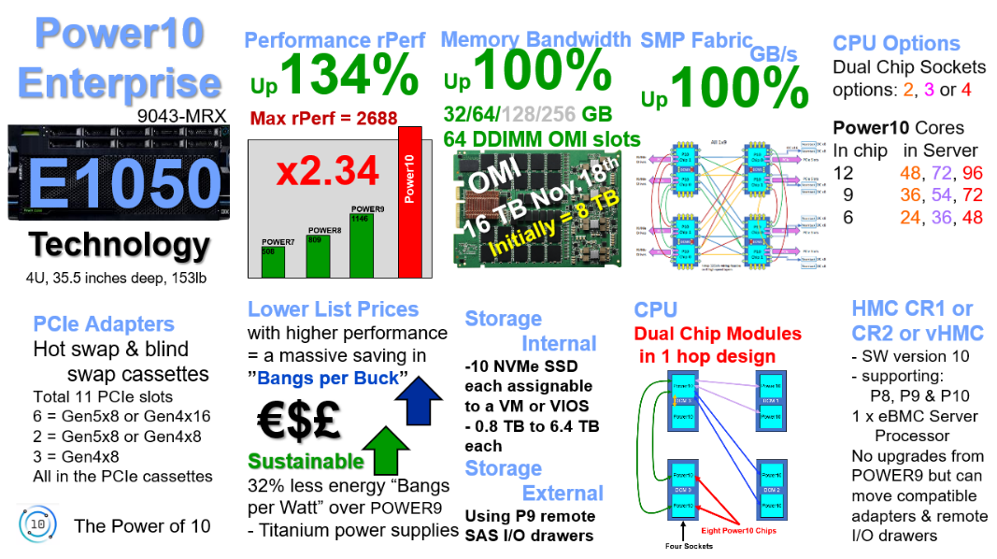
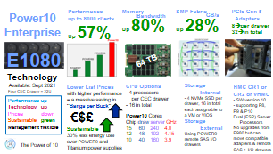
Power10 as
Infographics
Power10 chip
Power10 Infrastructure
Scale-out
Enterprise Midrange
Enterprise Top End

Slide 3
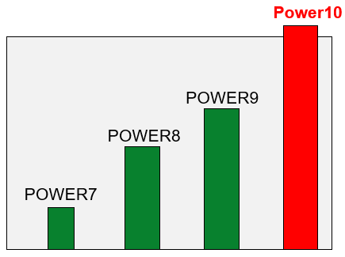
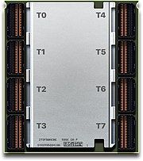
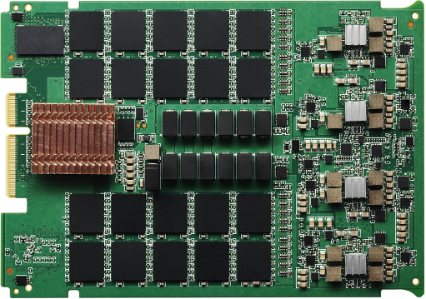
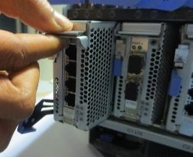
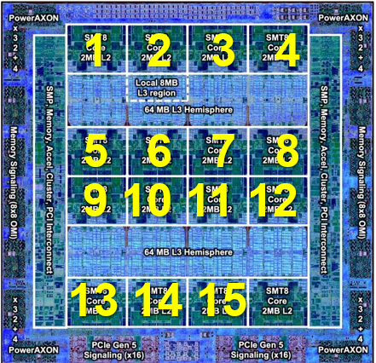
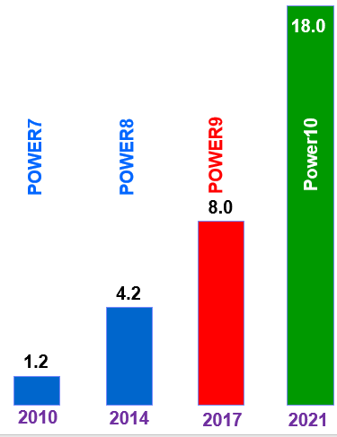
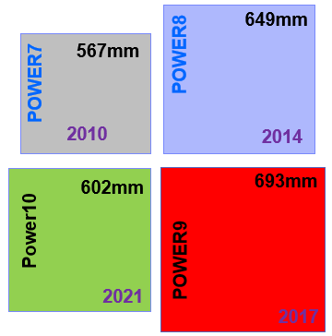
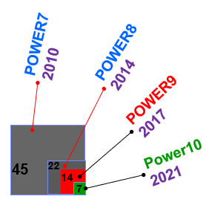
Performance rPerf →25% by Core Count →30% Thread Strength →100% DCM [depending on the model]
SMP Fabric Up 28%-100%
Memory Open Memory Interface Up 80-100%
PCIe Gen 5 Adapters Faster by 2x than Gen4 4x than Gen3
Power10 Processor
Technology
GB/s
Bandwidth
8TB 16TB 64TB
Eight direct connections
Power10 Processor Chip Cores up to 15 SMT=8 → 120 threads Core Chip L1 80KB 1.2 MB L2 cache 2MB 30 MB L3 cache 8MB 120 MB E1080 total L3 1.9 GB Accelerator engines: MMA (AI), Crypto, GZIP Full memory encryption
Devices per Processor Chip 18 billion
CPU Lithography in nm: 7nm
CPU die size in mm²
Max CPU Cores E1080=240, E1050=96, S1024=48
The Power of 10
SCM DCM

Slide 4
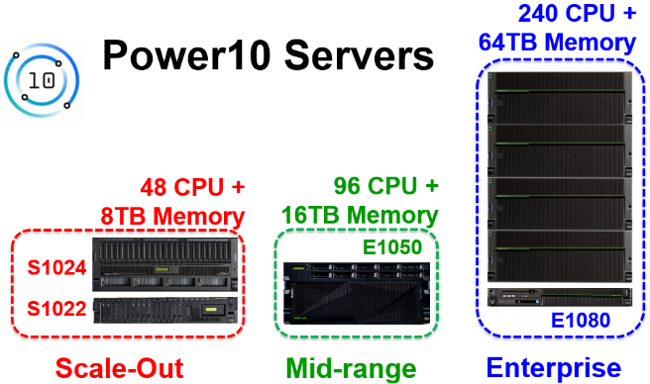
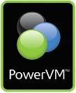
Mission Critical World class PowerVM virtualisation for virtual machine scaling → 240 CPUs & 64 TB RAM, 32 PCIe Gen 5 adapters + remote I/O Ready for the worlds biggest applications: SAP-HANA, SAS, DB2 Oracle, WebSphere ...
For Automation PowerVC (OpenStack): Private Cloud for simple standard VM rollout in seconds. Cookie cutter style Ansible: DevOps automation of tasks for rapid consistent reactions by flexible task based scripts
Higher Security - Power10 future proof, CPU core encrypt engines
- New PowerSC 2.0
→ Toolbox of many tools from the IBM security experts
Application Modernisation Red Hat Openshift co-existing with classic RDBMS & large workloads. Containerized Workloads, for agile program teams, with fast Openshift roll out
Power10 Infrastructure
PowerVM
PowerSC
PowerVC
PowerVS
OpenShift
Ansible
Investment Protection Power Enterprise Pools like POWER9. Simple, live CMC Dynamic Capacity control CPU & RAM for whole Power10 range
PowerVS on IBM Cloud Power10 soon for
Frictionless inter-working On-prem & in the Cloud
Greener Tech
Higher performance
but less electrical power = more efficient computing & lower price per rPerf. Fewer servers for the same job. Higher “Bangs per Watt”
Sustainable!
Low environment life-cycle impact:
design,
manufacturing,
computing &
recycling
Less waste & due to recycling
AIX
IBM i
Red Hat +
Openshift
The Power of 10
PEP 2.0
Power Virtual Server

Slide 5
Oracle Certified not the HW but to the AIX level & all current AIX versions for Oracle 12 → 19. AIX + Oracle most popular for large RDBMS with high CPU core & largest data. Power10 S1014 qualify for Oracle SE2
Dynamic LPAR Rapid live add & remove in CPU cores, RAM and adapters for all 3 OS. AIX + IBM i = built in. Linux add a few special RPMs Live Partition Mobility between servers & across 3 Power generations
AIX Memory Expansion Low price per server to multiply the size of effective memory set by an Expansion Factor. Supports 4 KB + 64 KB pages using low overhead Power10 CPU core compression
Advanced Features - Simplified Remote Restart with PowerVC - LPAR modes: P8, P9 & P10 - MMA for in-core AI inferencing & machine learning - Hypervisor mirroring - njmon approved ☺
Power10 Infrastructure
IBM i
Oracle RBMS
Messaging
Power10 servers are designed to improve scale, performance, and security while delivering class-leading reliability.
Respond faster
Protect data from core to cloud
Streamline insights AI and automation
Maximize RAS
OS Support
HMC v10+
VIOS 3.1.3.21+
AIX no VIOS: 73-0-2, 72-5-4, 7200-4-6
AIX with VIOS 73-0-1, 72-5-1, 72-4-2, 71-5-6
IBM i support 7.3TR12, 7.4TR6 & 7.5
SLES 15 SP3 +
RHEL 8.4 & 9
RH OpenShift 4.9+
Dynamic LPAR
IBM i
Super efficient, whole stack OS is very popular on the smaller Scale-Out servers with low CPU core count and the E1080 for larger numbers of VMs. IBM i support on all Scale-out & E1080
PowerHA
High availability clusters based on shared disks. Quick Automatic failover or manual takeover between servers and restart service with minimum down time. Also, VM Recovery Manager
AIX AME
PowerHA / VMRM
Advanced Features
Operating Systems
The Power of 10

Slide 6
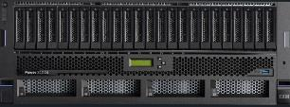
Power10 Scale-Out Technology Six options
S1024 ➔ XL CPU Core options 12, 24, 32, 48 Memory Slots 32 (2U or 4U) Memory Max 2*TB → 8 TB PCIe slots 10 [8+2] NVMe SSD 16 NVMe max 102 TB
S1022 ➔ L CPU Core options 12, 24, 32, 40 Memory Slots 32 (2U only) Memory Max 2*TB → 4TB PCIe slots 10 [8+2] NVMe SSD 8 NVMe max 51 TB
L1024 for Linux As S1024 with up to 25% cores running AIX or IBM i
+ Terms and Conditions
L1022 for Linux As S1022 with up to 25% cores running AIX or IBM i
+ Terms and Conditions
4U, 28 inches deep, max 45Kg
S1014* ➔ S CPU Core options 4, 8 one socket Memory Slots 8 Memory Max 512*GB → 1 TB
PCIe slots 5 [4+1] NVMe SSD 16 NVMe max 102 TB
S1022s ➔ M CPU Core options 4, 8, 16 Memory Slots 16 Memory Max 1 TB → 2 TB PCIe slots 10 [8+2] NVMe SSD 8 NVMe max 51 TB
2U, 32 inches deep, max 34Kg
The Power of 10
PCIe Slots Total [Gen5 + Gen4]
* Until 9 Dec 2022
* Oracle SE2 qualified
4U
2U

Slide 7
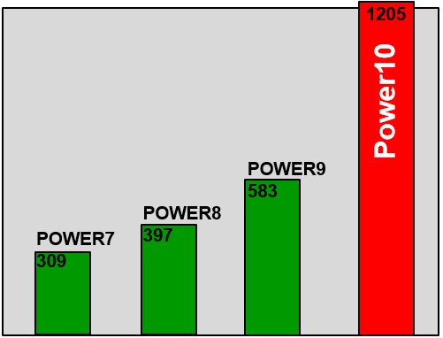
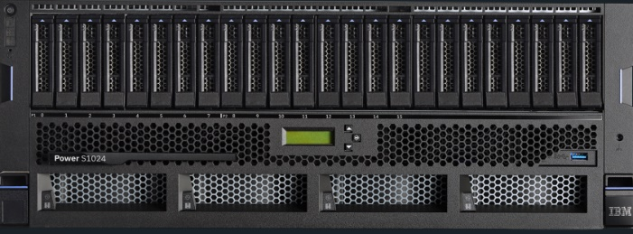
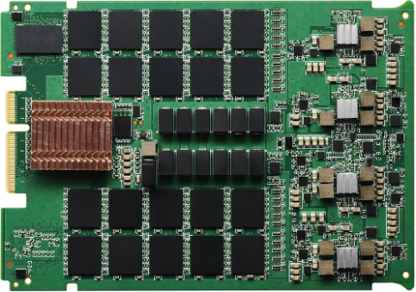
Power10 Scale-Out
S1024
Technology
Performance rPerf
Memory Bandwidth
SMP Fabric GB/s
CPU Options - 2 or 4 Power10 - 1 or 2 Sockets - Upgrade 1→2 on some models
Chip Server GHz cores cores 12 - 48 3.9 8 - 32 4.0 6 12 24 4.0 ^ single socket
Up128% Max rPerf = 1332
x2.28
Up100% 16/32/64/128/256 GB 32 DDIMM OMI slots
Up100%
- 1 or 2 sockets
- 1 hop design
9105-42A
OMI
8TB - 9th Dec
Initially 2TB
Power10
Power10
Power10
Power10
4U, 28 inches deep, 98lb
Lower List Prices with higher performance = a massive saving in ”Bangs per Buck” €$£ Sustainable 25% less energy “Bangs per Watt” over POWER9 -Titanium power supplies
Storage Internal - 16 NVMe SSD - each assignable to any VM or VIOS - 0.8, 1.6, 3.2 & 6.4TB - Total 102 TB - NVMe bays use 1 or 2 PCIe slots Storage External Using remote SAS I/O drawers like POWER9
PCIe Gen5 Adapters slots Supporting Gen4 & 3 Total 10 PCIe slots 4 = Gen5x8 [Gen4x16] 4 = Gen5x8 2 = Gen4x8 Concurrent maintenance using HMC process Remote I/O slots Up to 2 Remote PCIe I/O drawer like POWER9
HMC CR1, CR2 or vHMC - SW version 10 - supporting P8, P9 & P10 1 x eBMC Server Processor No upgrades from POWER9 but can move compatible adapters
Also L1024
Linux version
with up to 25% cores running AIX or IBM i
9786-42H
The Power of 10

Slide 8
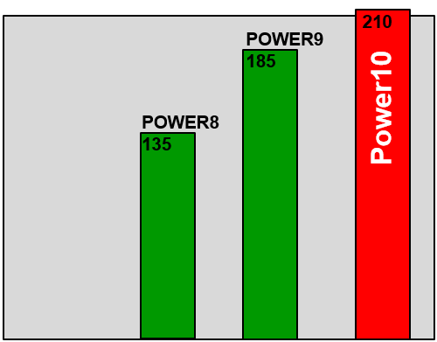
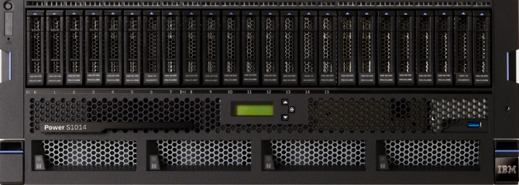
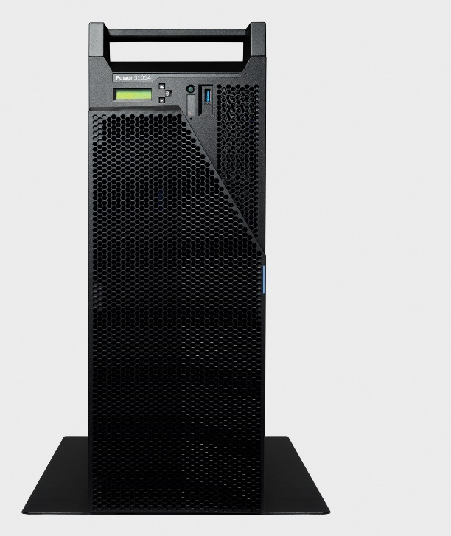
Power10 Scale-Out
S1014
Technology
Performance rPerf
Memory Bandwidth
SMP Fabric GB/s
CPU Options - 1 Power10 - 1 Sockets Cores Server GHz in chip cores 8 8 3.9 4 4 3.9 Only a single socket 4 core Rack or Tower 8 core Rack only
Up37% Max rPerf = 254
Up100% 16/32/64/128 GB 8 DDIMM OMI slots
Up100%
- 1 socket
- 0 hop design!
9105-41B
OMI
Single
Power10
chip
1TB - 9th Dec
Initially 512 GB
Power10
4U
Lower List Prices with higher performance = a massive saving in ”Bangs per Buck” €$£ Sustainable Less energy use over POWER9 and Titanium power supplies
Storage Internal - 16 NVMe SSD each pair assignable to a VM or VIOS - 0.8, 1.6, 3.2 & 6.4TB - Total 102 TB - each NVMe bay uses a PCIe slot Storage External Using P9 remote SAS I/O drawers
PCIe Gen5 Adapters slots Supporting Gen4 & 3 Total 5 PCIe slots 1 = Gen5x8 [Gen4x16] 3 = Gen5x8 1 = Gen4x8 Concurrent maintenance using HMC process Remote I/O slots 1 Remote I/O drawer Rack only
HMC CR1 or CR2 or vHMC - SW version 10 - supporting P8, P9 & P10 1 x eBMC Server Processor No upgrades from POWER9 but can move compatible
19” Rack - or – Tower Option
The Power of 10
Oracle SE2 ready

Slide 9
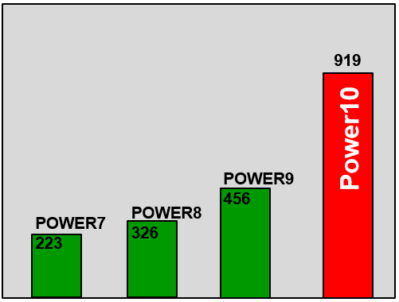
Power10 Scale-Out
S1022
Technology
Performance rPerf
Memory Bandwidth
SMP Fabric GB/s
CPU Options - 2 or 4 Power10 - 1 or 2 Sockets - Upgrade 1→2 Chip Server GHz cores cores 10 - 40 3.9 8 - 32 4.0 6 12 24 4.0 ^ single socket
Up125% Max rPerf = 1024
x2.25
Up100% 16/32/64/128 GB 32 DDIMM OMI slots
Up100%
9105-22A
- 1 or 2 sockets
- 1 hop design
OMI
4 TB - 9th Dec
Initially=2 TB
Power10
Power10
Power10
Power10
2U, 32 inches deep, max 70lb
HMC CR1 or CR2 or vHMC - SW version 10 - supporting P8, P9 & P10 1 x eBMC Server Processor No upgrades from POWER9 but can move compatible adapters
Lower List Prices with higher performance = a massive saving in ”Bangs per Buck” €$£ Sustainable Less energy use over POWER9 and Titanium power supplies
Storage Internal - 8 NVMe SSD each pair assignable to a VM or VIOS - 0.8, 1.6, 3.2 & 6.4TB - Total 51 TB - each NVMe bay uses a PCIe slot Storage External Using P9 remote SAS I/O drawers
PCIe Gen5 Adapters slots Supporting Gen4 & 3 Total 10 PCIe slots 4 = Gen5x8 [Gen4x16] 4 = Gen5x8 2 = Gen4x8 Concurrent maintenance using HMC process Remote I/O slots 2 Remote PCIe I/O drawer
L1022
Linux version
with up to 25% cores running AIX or IBM i
9786-22H
The Power of 10

Slide 10
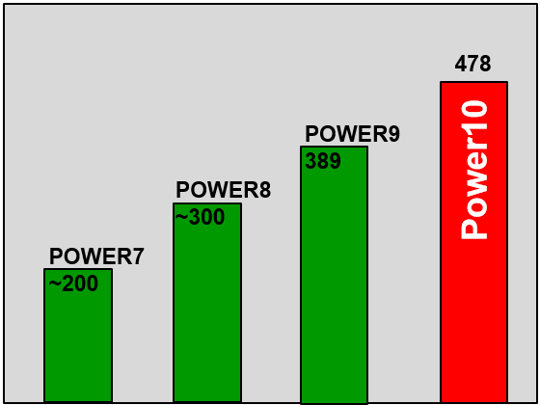
Power10 Scale-Out
S1022s
Technology
Performance rPerf
Memory Bandwidth
SMP Fabric GB/s
CPU Options - 1 or 2 Power10 - 1 or 2 Sockets - Upgrade 1→2 Cores Server GHz in chip cores 8 8 16 3.9 4 4 - 3.9 ^ single socket 4 core=single socket
Up 23% Max rPerf = 478
Up100% 16/32/64/128 GB 16 DDIMM OMI slots
Up100%
9105-22B
- 1 or 2 sockets
- 1 hop design
OMI
2 TB - 9th Dec
Initially = 1 TB
Power10
Power10
switch
switch
2U
Lower List Prices with higher performance = a massive saving in ”Bangs per Buck” €$£ Sustainable Less energy use over POWER9 and Titanium power supplies
Storage Internal - 8 NVMe SSD each pair assignable to a VM or VIOS - 0.8 TB to 6.4 TB - Total 51 TB - each NVMe bay uses a PCIe slot Storage External Using P9 remote SAS I/O drawers
eSCM “Entry Single Chip Module” → one Power10 chip with a PCIe switch for I/O
No Remote I/O slots
PCIe Gen5 Adapters slots Supporting Gen4 & 3 Total 10 PCIe slots 4 = Gen5x8 [Gen4x16] 4 = Gen5x8 2 = Gen4x8 Concurrent maintenance using HMC process
The Power of 10

Slide 11
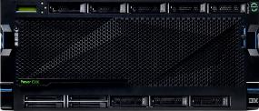
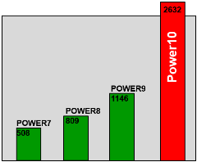
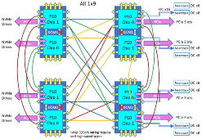
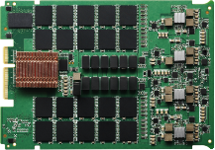
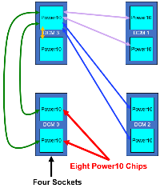
Power10 Enterprise
E1050
Technology
Performance rPerf
Memory Bandwidth
SMP Fabric Up100%
CPU Options Dual Chip Sockets options: 2, 3 or 4
Power10 Cores In chip in Server 12 48, 72, 96 9 36, 54, 72 6 24, 36, 48
Up134% Max rPerf = 2688
x2.34
Up100% 32/64/128/256 GB 64 DDIMM OMI slots
GB/s
9043-MRX
OMI
16 TB - 9th Dec
Initially = 8 TB
4U, 35.5 inches deep, 153lb
Lower List Prices with higher performance = a massive saving in ”Bangs per Buck” €$£ Sustainable 32% less energy “Bangs per Watt” over POWER9 - Titanium power supplies
Storage Internal -10 NVMe SSD each assignable to a VM or VIOS - 0.8 TB to 6.4 TB each Storage External Using P9 remote SAS I/O drawers
CPU Dual Chip Modules in 1 hop design
HMC CR1 or CR2 or vHMC - SW version 10 - supporting: P8, P9 & P10 1 x eBMC Server Processor No upgrades from POWER9 but can move compatible adapters & remote I/O drawers
PCIe Adapters Hot swap & blind swap cassettes Total 11 PCIe slots 6 = Gen5x8 or Gen4x16 2 = Gen5x8 or Gen4x8 3 = Gen4x8 All in the PCIe cassettes
The Power of 10

Slide 12
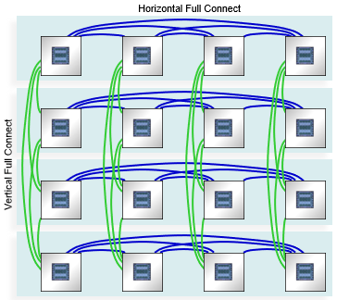
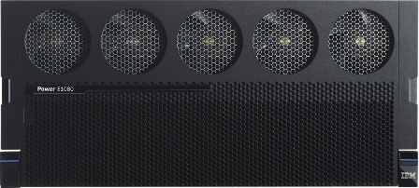
Performance up to 8000 rPerfs Up 57%
Memory Up 80%
SMP Fabric Up 28%
PCIe Gen 5 Adapters 8→per drawer 32→in total
Power10 Enterprise
E1080
Technology
Bandwidth
GB/s
64 TB
Available: Sept 2021
Lower List Prices with higher performance = a massive saving in ”Bangs per Buck” €$£ Sustainable 30% less energy use over POWER9 and Titanium power supplies
CPU Options - 4 processors per CEC drawer - 16 in total
Power10 Cores Chip draw server GHz 15 60 240 4.0 12 48 192 4.15 10 40 160 3.9
Storage Internal - 4 NVMe SSD per drawer, 16 in total each assignable to a VM or VIOS Storage External Using POWER9 remote SAS I/O drawers
HMC CR1 or CR2 or vHMC - SW version 10 - supporting: P8, P9 & P10 Dual (FSP) Server Processors No upgrades from E980 but can move compatible adapters & remote I/O drawers
Four CEC Drawer = 22U
Performance up
Technology up
Prices down
Sustainable green
Management flexible
The Power of 10

Slide 13
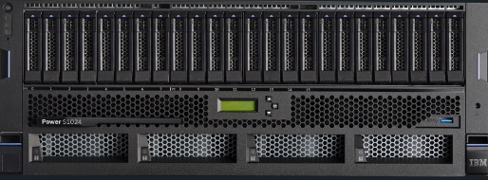
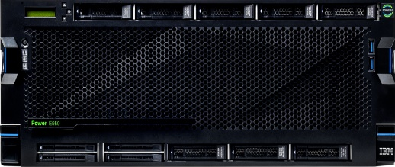
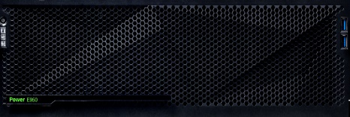
240 CPU +
64TB Memory
Power10 Servers
48 CPU +
8TB Memory
96 CPU +
16TB Memory
E1050
S1024
S1022
E1080
Scale-Out
Mid-range
Enterprise

