Slide 1
What’s New in IBM Copy Services Manager V6.3.11
IDEA CSM-I-139 - Allow larger size volumes for FC targets and SGC recovery volumes
Support for connecting to DS8000 storage systems using z/OS Passtickets
IDEA CSM-I-155 - LSS level selection for ESESizer and SGCSizer
Support Scheduled Task Run External Script action with SSH key pair
IDEA CSM-I-162 - Display Role Pair on DS8000 Global Mirror Info Tab
IDEA CSM-I-160 - Automatically reconnect active and standby servers after a disconnect
Support LDAP for z/OS RACF

Slide 2
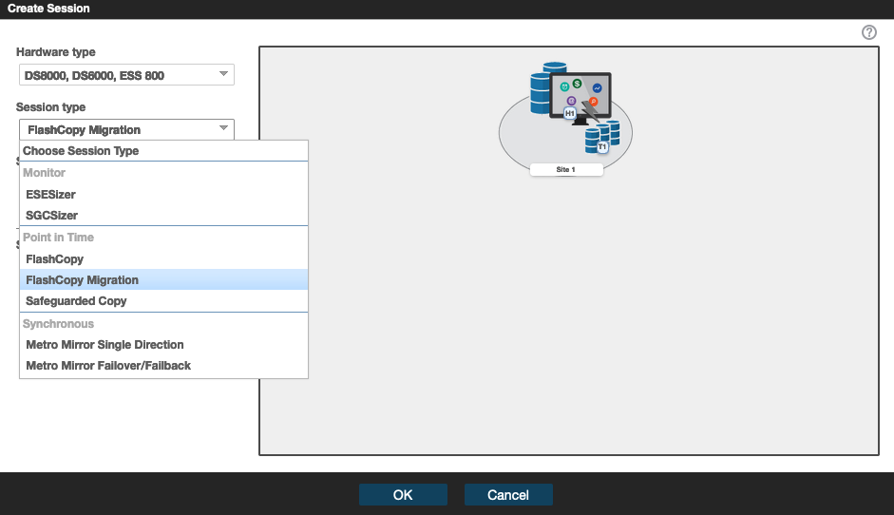
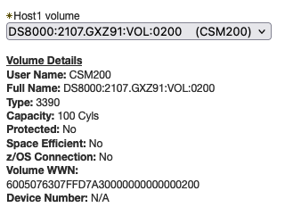
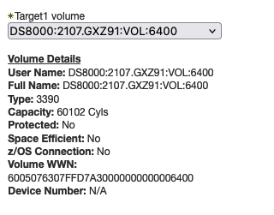
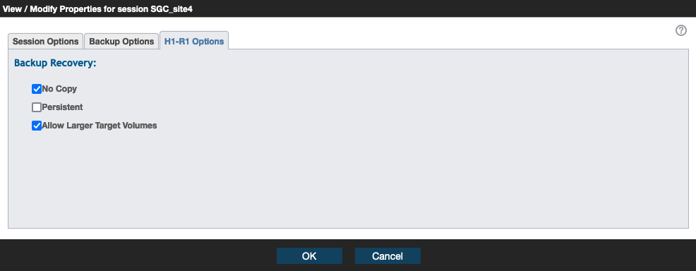
IDEA CSM-I-139 - Allow larger size volumes for FC targets and SGC recovery volumes
Today a FlashCopy session target and a Safeguarded Copy session recovery volume, have to be the same size as the source volume
Customers have requested the ability to use FlashCopy for migration
In 6.3.11, a new “FlashCopy Migration” session is now available which allows customers to define targets with a larger size
Customers have also requested allow Safeguarded Copy recovery volumes of a larger size.
Having larger SGC recovery volumes allows customers to setup a pool of volumes that could be a recovery volume for any of their volumes, in case they need to recover only one, or a subset of volumes, such as with products like IZBR

Slide 3
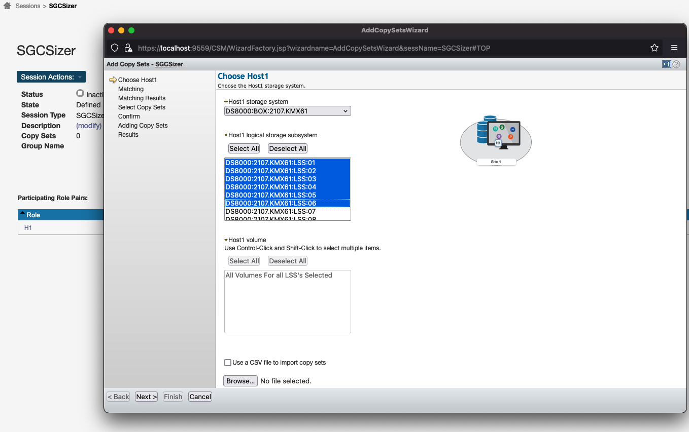
IDEA CSM-I-155 - LSS level selection for ESESizer and SGCSizer
Both the ESESizer and SGCsizer sessions only require a single volume in the copy set
In previous releases, while you could multi-select all the volumes in an LSS, you had to go through the wizard another time to choose the volumes in a different LSS
In 6.3.11, you can now multi-select at the LSS level
When multi-selecting LSSs, all volumes in the selected LSS will get added to the session
In addition, when single selecting an LSS, there are new Select All or Deselect All buttons allowing for easier selection

Slide 4
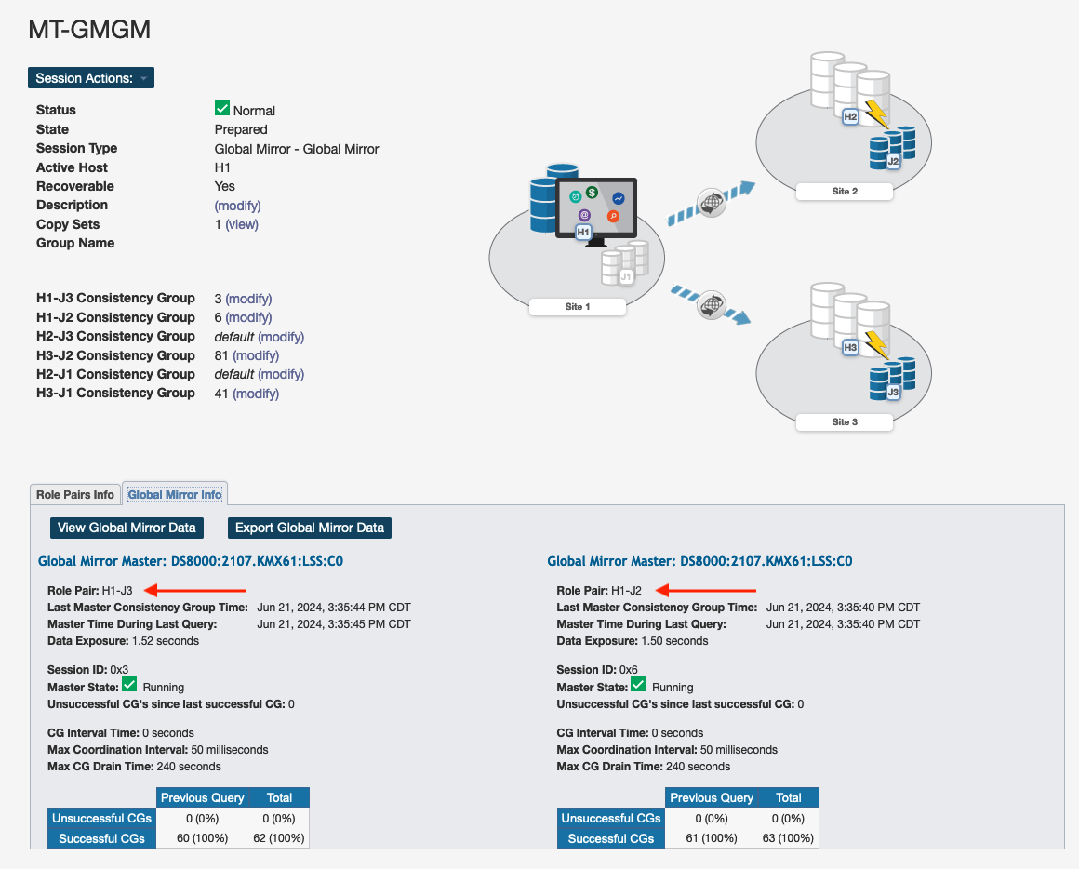
IDEA CSM-I-162 - Display Role Pair on DS8000 Global Mirror Info Tab
CSM 6.3.9 and DS8000 9.4 introduced the ability to have more than 1 active GM role pair in a session
Both the Global Mirror – Global Mirror session (which defines a multi-target Global Mirror relationship), as well as the 4 Site Replication Enhanced session (which defines a cascaded Global Mirror relationship), might have more than one active Global Mirror relationship
When there is more than one Global Mirror relationship, the Global Mirror Info tab will display the details for each of the Global Mirror sessions on the hardware
Starting with 6.3.11, a new “Role Pair” field will now display with each entry, so that you can easily tell which details are for what Role Pair in the session

Slide 5
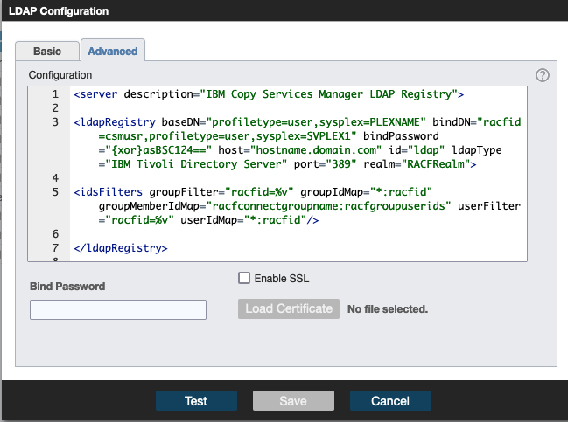
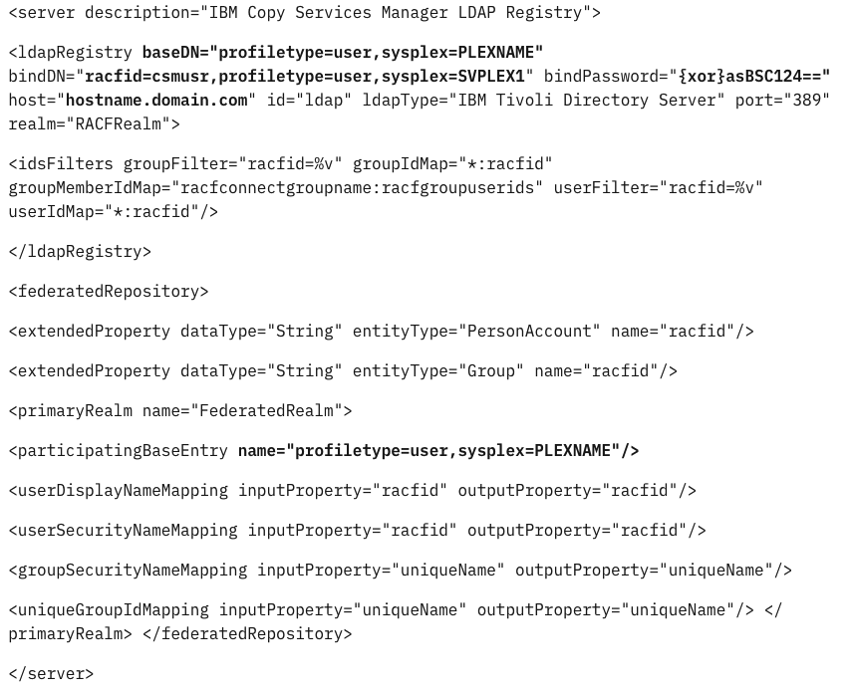
Support LDAP for z/OS RACF
CSM has always supported both Basic users as well as LDAP users
Starting with 6.3.11, CSM now supports the ability to define an LDAP server running on z/OS with the SDBM backend
This setup can be done through the Advanced Setup tab for LDAP using the following XML, updating the bold values for your environment
This support provides mainframe customers the ability to setup CSM on a Distributed server while still using the same RACF users defined on the z/OS system with the volumes that CSM is managing

Slide 6
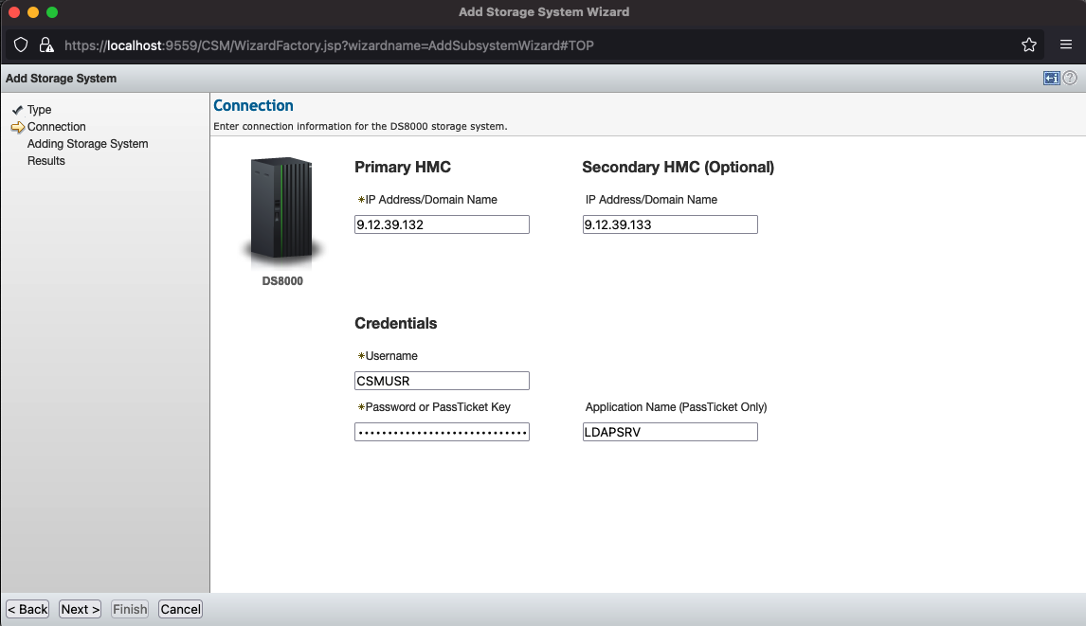
Support for connecting to DS8000 storage systems using z/OS Passtickets
Today CSM supports connecting to the DS8000 storage system using a userid and a static password
With most customers now requiring rolling passwords for security, this becomes difficult to have to modify this password across all storage system connections when the password changes
Starting with CSM 6.3.11, CSM can now connection to the DS8000 with a z/OS Passticket
Users in RACF can be setup with a Passticket key which can be added to the CSM DS8000 connection instead of a password. Every time CSM attempts to connect to the storage system, a new Passticket is created to authenticate to RACF. This means the password is ALWAYS different, and doesn’t need to be modified in CSM
To support DS8000 Passticket connections, the DS8000 must be setup for LDAP for z/OS RACF with the SDBM backend.

Slide 7
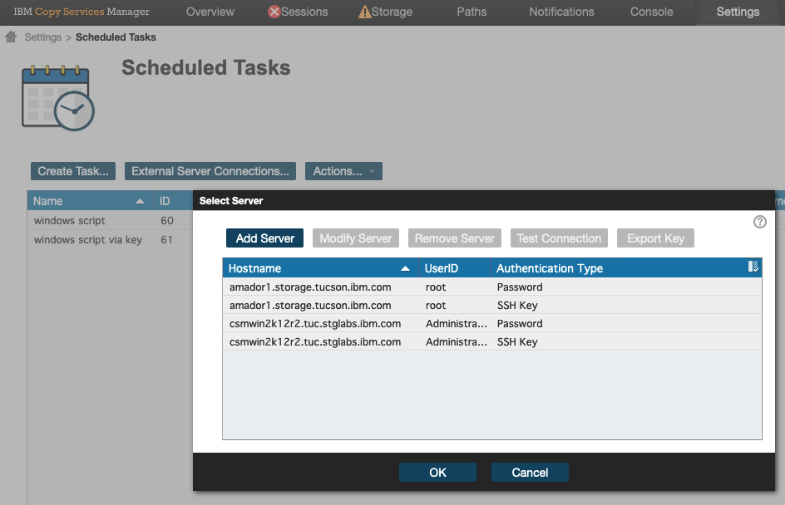
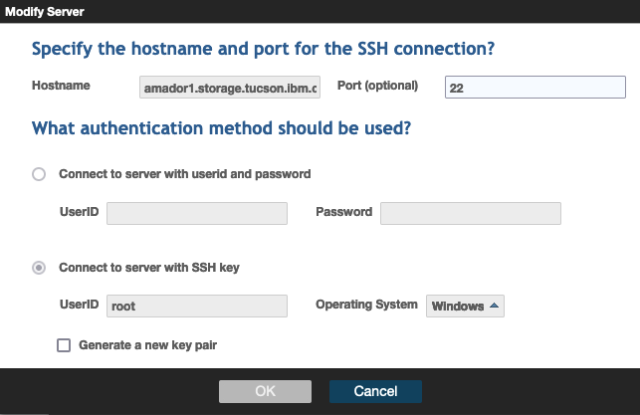
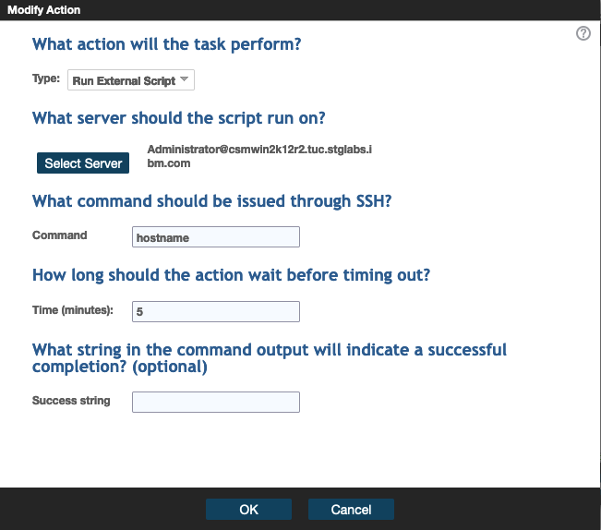
Support Scheduled Task Run External Script action with SSH key pair
The Scheduled Task Action ‘Run External Script’ allows customers today to execute external scripts via an SSH userid / password
Starting with 6.3.11, customers can now setup an SSH key pair for the Run External Script action instead of using a static password
To setup an SSH key you can now define an External Server connection which can be used across multiple Scheduled Tasks
If the server connection is setup for an SSH key connection, you can then export the key and apply that key on the server that will be called by the Scheduled Task

Slide 8
IDEA CSM-I-160 - Automatically reconnect active and standby servers after a disconnect
When an Active and Standby server disconnects the standby will go into a Disconnected Consistent state
Starting with the 6.3.11 release, after a disconnect, the active server will automatically attempt to reconnect to the standby
The active will attempt to reconnect by default every minute for up to 10 minutes. If it cannot reconnect within that time a manual reconnect will be necessary
When the active server automatically reconnects, before sync’ing the servers, a backup will be taken automatically on the standby server to ensure a consistent image is preserved of the standby config
If a takeover is issued to the standby server, the active will see this on the next attempt to reconnect and will stop trying to reconnect
NOTE: When upgrading the active and standby servers it is always recommended to issue a takeover on the standby server prior to the upgrade process
1
Active and Standby Servers Connected
Active and Standby Servers Disconnected (example: reboot active server
x
2
Active automatically attempts to reconnect Standby
3
Active and Standby Servers Reconnected with no human interaction
4

Slide 9
IBM System Storage Ideas Portal!!! -> New RFE Portal for CSM
https://ibm-sys-storage.ideas.ibm.com/ideas?project=CSM
The CSM RFE process has been converted to the new IBM System Storage Ideas Portal.
With the change, IBM is moving to a more common Aha! based process for customers to submit ideas across all IBM products.
All existing RFEs have been converted to Ideas. When you visit an RFE for status it will direct you to the Idea for that RFE in the Idea Portal.

Slide 10
Thank you!

Slide 11
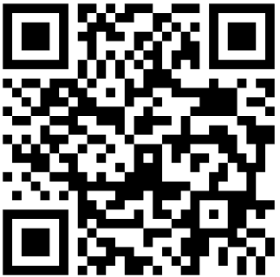
Accelerate with ATG Technical Webinar Series - Survey
Please take a moment to share your feedback with our team!
You can access this 6-question survey via Menti.com with code 2243 3599 or
Direct link https://www.menti.com/albneqj15g57
Or
QR Code

