Slide 1
IBM Enterprise vs LTO Tape Drive Comparison
Reena Patel, IBM Data Retention & Tape Systems (DR&T) Specialist
Ace Lopez, Sales Executive,
IBM Storage Solutions & Internet of Things

Slide 2
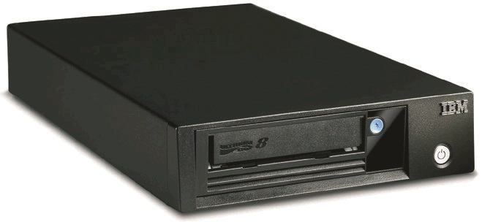
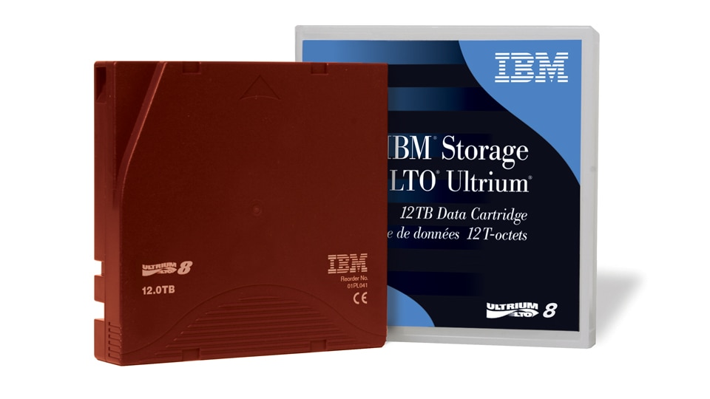
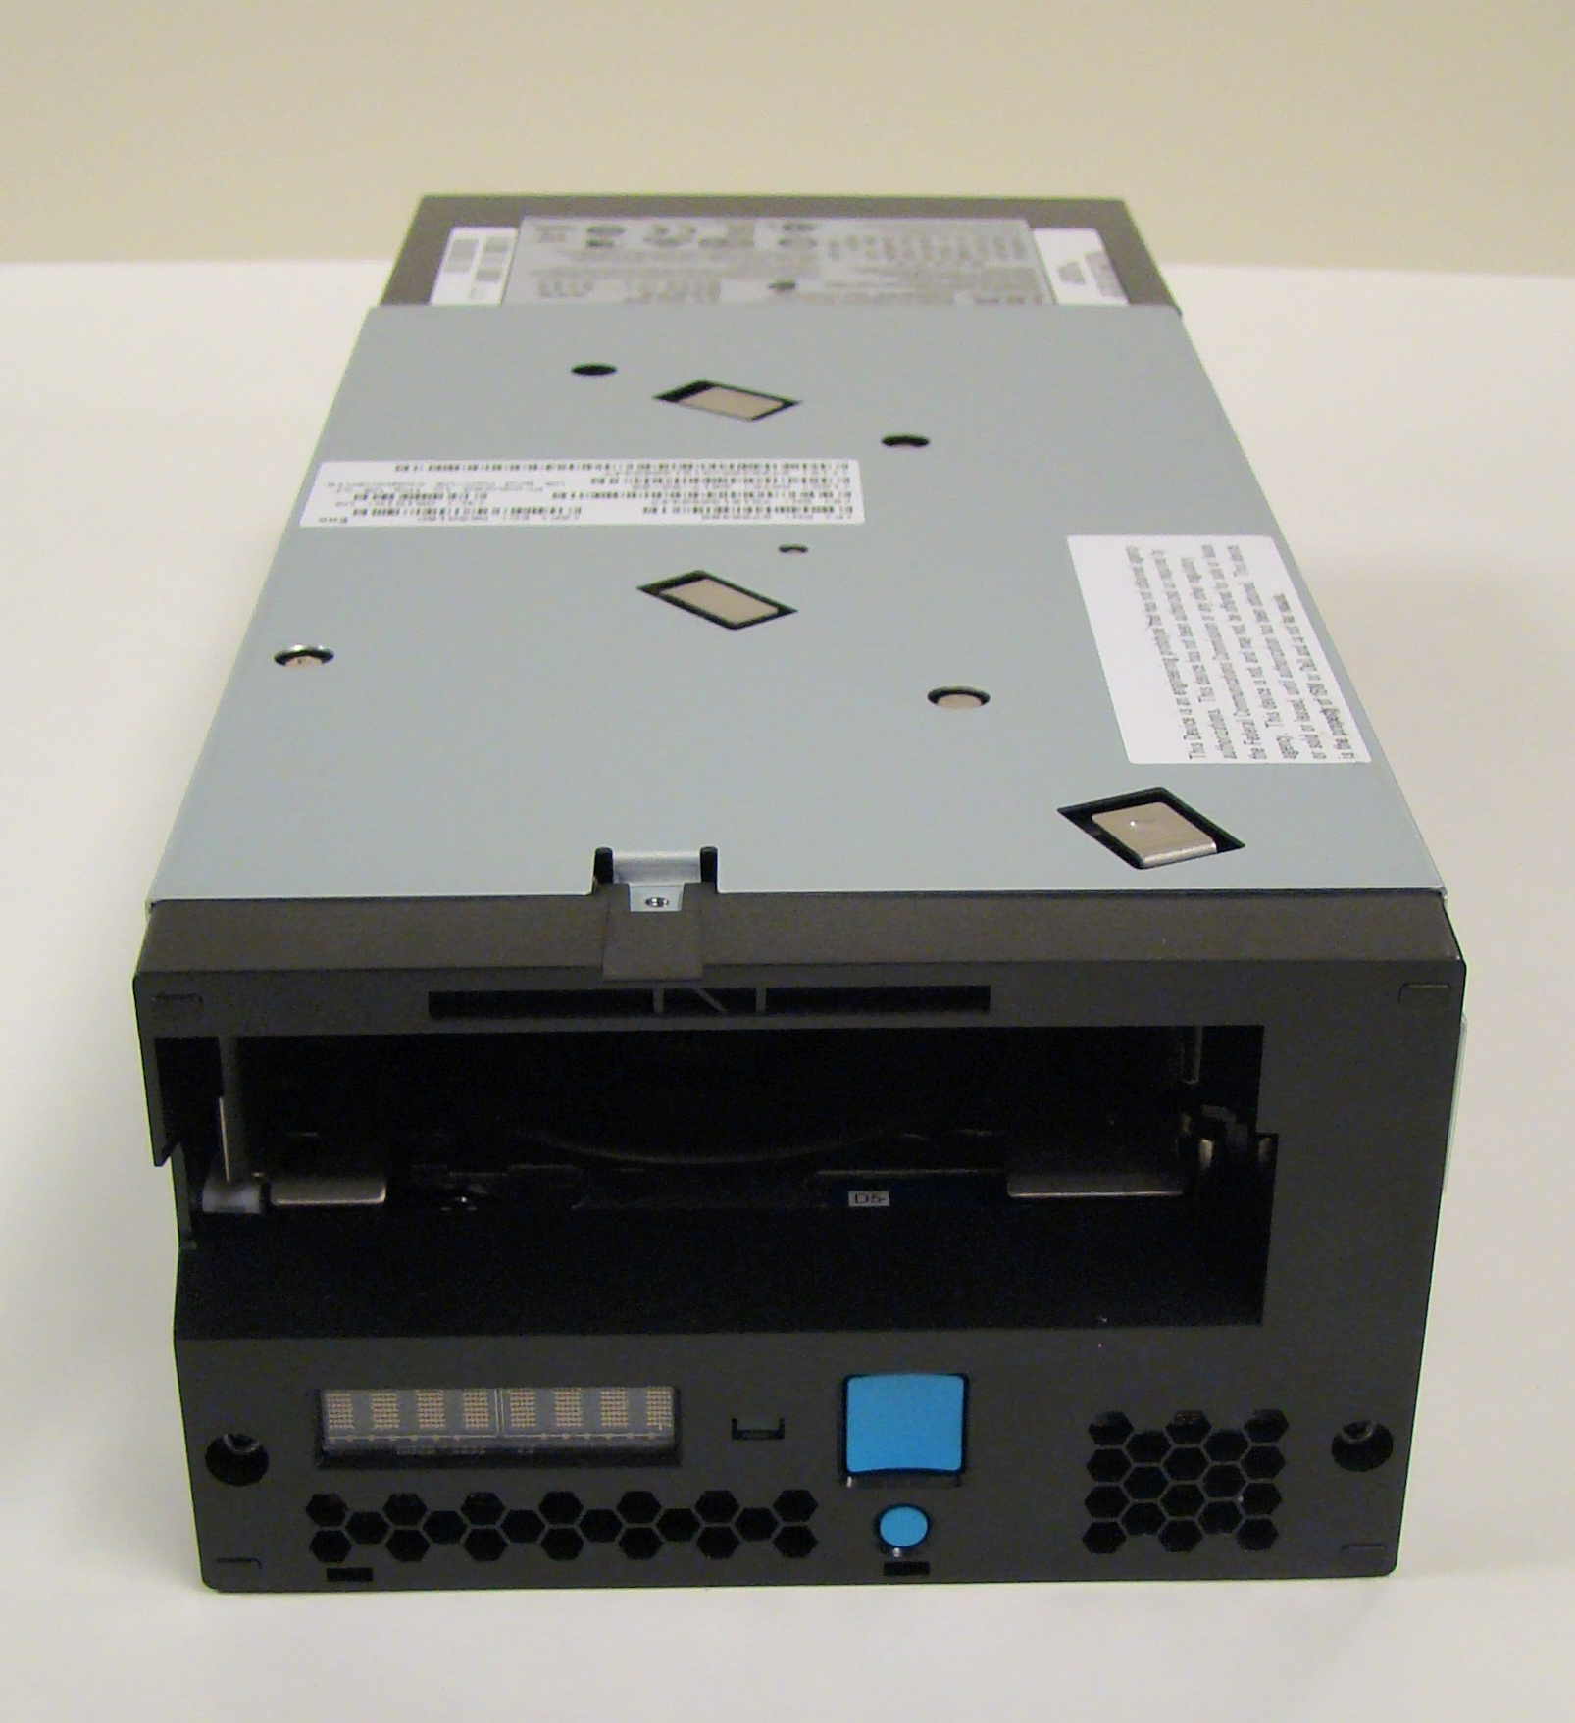
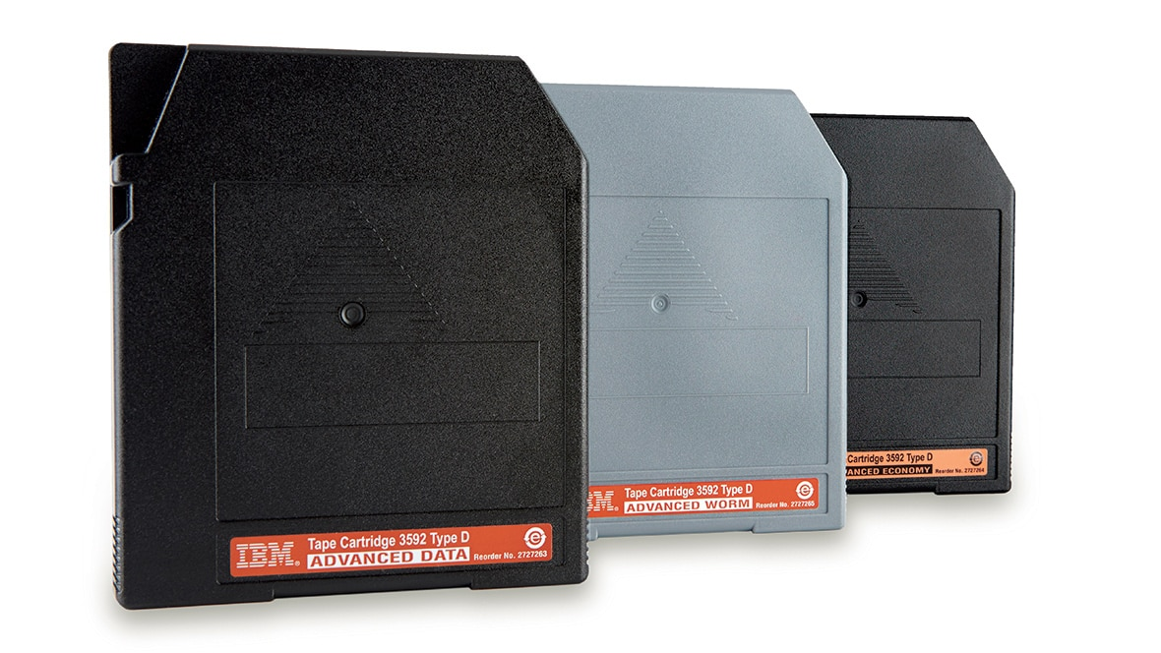
IBM Tape Product Lineup
Tape Drives
Characteristics
Product Specifications
The LTO family was first introduced in 2000
We are now on the 8th Generation or LTO8
Compatible drives are available from third party vendors
Open Systems drive only, cannot be used on the mainframe
No media “upformating”; each new generation has its own cartridge
LTO: Linear Tape Open
or Ultrium
Newest Product: LTO8
Introduced: 2017
Capacity: 12TB (uncompressed)
Performance: 360 MB/s (Native)
Enterprise Tape:
IBM’s Enterprise family of tape was introduced in 2003
We are now on the 6th Generation or TS1100
IBM exclusive drive
Overall superior to LTO in capacity, performance and reliability
Used for both Open Systems and mainframe
Allows “upformating” of media, new drives produce higher capacity with older generation media
IBM TS1100
“Jaguar”
Newest Product: TS1155
Introduced: 2017
Capacity: 15TB (compressed)
Performance: 360 MB/s (Native)

Slide 3
Value of a Tape Innovation Platform
Innovation Platform: A space to innovate, generate ideas, learn, drive change, collect client and market requirements, explore and set strategies, diagnose challenges, identify opportunities, achieve development goals, boost productivity, create new products and features, etc.
Tape Innovation Platform: IBM Tucson
Benefits:
New features are offered to the LTO Consortium for consideration, selection, and inclusion in future LTO releases
The Volume line (LTO) enables the Innovation platform
Workloads that demand enhanced features benefit from tested and proven Enterprise Tape technology

Slide 4
Volume Line (LTO) Enables Innovation Platform & Value Line
Feature Inputs
Innovation
Platform
Feature
Selection
Tape Vendors Build Go-To-Market Offerings to Add Value for Their Markets
Next Gen
Workloads
Big
Data
Tape Features
Performance
Cost
Interfaces
Optimization
Reliability
Durability
Continuity
Etc.
LTO Generations | LTO-6 | LTO-7 | LTO-8 | LTO-9
Max Format Capacity (Native) | 2.5 TB (L6) | 6 TB (L7) | 12 TB (L8) | Up to 24 TB (L9)
Native Data Rate | 160 MB/s | 300 MB/s | 360 MB/s | Up to 450 MB/s
MRDs
Client
Feedback
Vote
Adoption
…
Really
Smart
People
IoT
Internal Selection
TS1100 Generations | TS1140 | TS1150 | TS1155 | Gen-6 | Gen-7
Max Format Capacity (Native) | 4 TB (JC) 1.6 TB (JB) | 10 TB (JD) 7 TB (JC) | 15 TB (JD) 7TB (JC) | Up to 20 TB (JE) 15 TB (JD) 10 TB (JC) | Up to 50 TB (JF) Up to 30 TB (JE) 15 TB (JD)
Native Data Rate | 250 MB/s | 360 MB/s | 360 MB/s | Up to 420 MB/s | Up to 1000 MB/s
Tape
Research
Forums “Future
of Tape”
…
Regulatory
Legacy
Any statements regarding IBM's future direction and intent are subject to change or withdrawal without notice, and represent goals and objectives only.

Slide 5
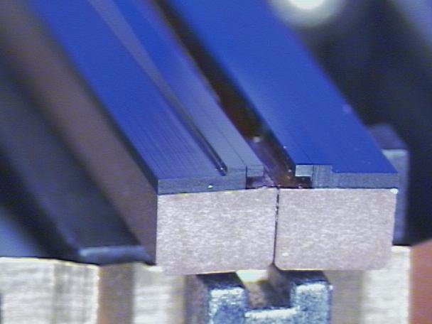
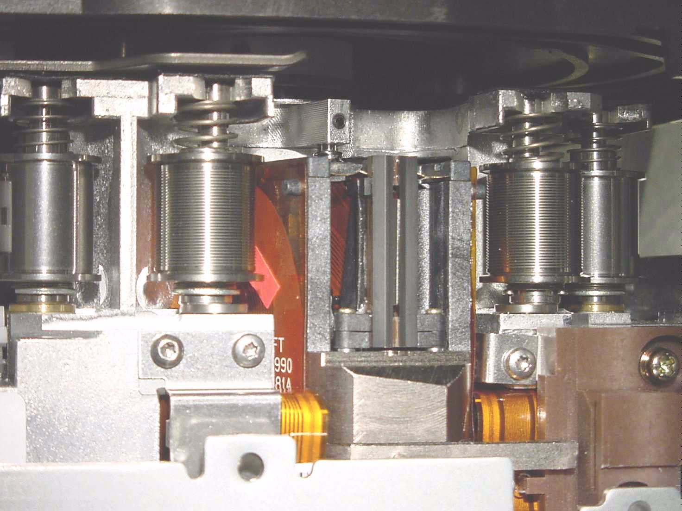
IBM Head and Tape Path Technology
Flat Head:
Head-actuator in drive:
What does it mean?
Minimal touching of the tape by the tape head or tape path
Extremely low wear
Long media life
Notes:
One of the criticisma Tape gets… is helical scan.. Data is written on stripped fashion.. Like a VCR.. A spinning hed that puts data on the tape like a barber pole. That created Tape wear… if you pause a VCR for a long period you will burn a hole in the Tape.
The silver flanges you see, rollers, can damage the tape so we reomved those.
Our technology allows a light touch built for Reuse. Very important in the new workloads

Slide 6
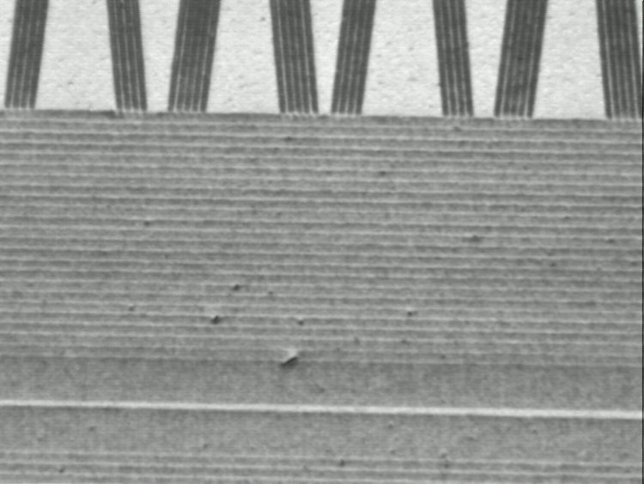
Tape positioning Technology
Servo Tracks
tape movement
Data Tracks
read/write head
What does it mean?
Servo reliably guides tape head
Servo also has positioning data
Provides high speed locate capability
Write wide / Read Narrow improves reliability
Notes:
This is shingling.....up to this point, the width of the writer matched the width of the track
We write wide and read narrow… for reliability.
Key is servo tracks keeps alignment of data. Ship rock on waves so servo tracks can ride out the storm or vibrations in a data center. Servo at the top A frame at image at the top..

Slide 7
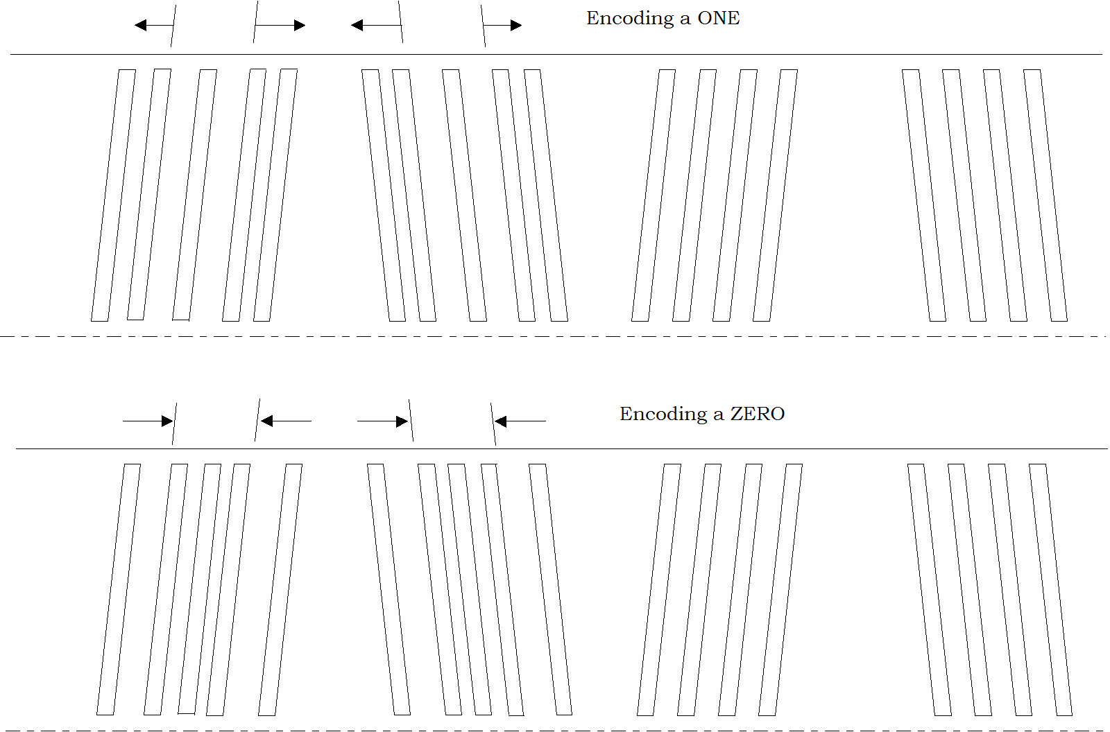
Decreased and Consistent Locate Times due to search speed, HRTD, LPOS...
Longitudinal Position (LPOS)
High Resolution Tape Directory
Notes:
LPOS sensing finds the right location.. Gives us mileposts markers. File 159 can be ofund. LTO does not have this. The exit ramp is precisely known with Enterprise.
With High Resolution Tape Directory and LPOS there is no interpolation. We are in high speed search mode. We arrive precisely where the file is. With LTO or other technologies we must interpolate.
Very fast, hope in and hop out.
There are 5 servo bands and 4 data bands. They are laid out
s-d-s-d-s-d-s-d-s. there are 512 data tracks, 64 wraps of 8 channels,16 index positions per bans
The servo bands perform 2 functions, exact positioning of the head to data track and knowledge of the longitudinal position (LPOS) of the tape. LPOS is determined by information that is encoded in the servo bands.
When data is written on tape the LPOS of that data is stored in the High Resolution Tape Directory (HRTD). The HRTD is written at the beginning of tape and read into tape menory when the tape is loaded. When the drive receives a Search or Locate command the location of the data is in the HRTD enabling the drive to go directly to the data.

Slide 8
Dynamic Compression Look Ahead Compression
Pass-thru
Maximizes cartridge capacity
2 compression options available
Analyze data in buffer
Dynamically selects compression
SDLC
Pass through (no compression)
Input
Data
Compressed
Data Stream
SLDC*
DC Block Diagram
*Streaming Lossless Data Compression
What does it mean?
The drive will automatically maximize cartridge capacity
No need to determine if data is already compressed in advance.
Notes:
In the old days you had to determine whether to compress the data. Some files are not able to compress. The file may have already been compressed by a server or an app. Like a trash compactor… its already packed as far as it will go. When this occurs attempting to further compress may actually inflate the file. Therefore, this feature keeps insures that the file is stored at the smallest size by comparing a file’s size with a compressed version of it. Therefore, less management, not having to switch the compressor on or off, not worrying about file inflation, etc. is elininated with this conmpressiion feature.
The Jaguar 1 Tape Drive uses the data compression algorithm used in LTO Gen 1 and Gen 2, known as SDLC "Streaming Lossless Data Compression Algorithm - (SDLC) ". SDLC is an implementation of a Lempel-Ziv class 1 (LZ-1) data compression algorithms. SDLC is an extension to the Adaptive Lossless Data Compression (ALDC) algorithm, which is used in leading industry tape products. Users of SDLC C can expect to achieve the same, or better, data compression as users of ALDC.
A key difference between SDLC and previous lossless compression algorithms is that record boundaries and file marks are encoded as control symbols in LTO-DC. The encoding of record boundaries and file marks as control symbols allows the compressed data stream to be separated into a serial stream of records and file marks by the decompressor without requiring additional information (e.g. from an attached header).
A second difference between SDLC and previous lossless compression algorithms is that SDLC allows switching between compression and no compression (pass-through) within the data stream. Control symbols within the data stream indicate the current compression state
The SDLC algorithm was standardized and is completely described in the ECMA-321:2001 "Streaming Lossless Data Compression Algorithm - (SDLC)".

Slide 9
Why Enterprise class TS1155 Tape drive vs LTO8?
Reliability-
Three times better than LTO ——> Fewer drives need to be replaced over time (300K load/unloads vs 100K with LTO)
Designed for 24 x 7 use
Reinforced tape cartridge (can withstand a 1 meter drop onto a tile floor while remaining operable with leader pin in place)
Performance and capacity
Faster drive
Up to 40% fewer drives needed* (Random Access Ordering can improve the seek-time between files on tape by 40% to 60%)
25% faster access to a file over LTO with High Resolution Tape Directory and Largest data buffer (2GB vs 1GB)
Highest single cartridge capacity
25% fewer cartridges needed compared to LTO8 (native 15TB capacity over 12TB)
Investment protection
Re-purpose TS1140/TS1150 drives as needed between Mainframe and Open systems (LTO does not support Mainframe attach)
*based on 100 MiB files and 1% random recall of repository in 60 hours. Reduction in drives is workload dependent.

Slide 10
Attribute | Enterprise Drives Offer: | Client Benefits
Lowest TCO across Generations | Highest single cartridge capacity Media up-formatting Field MES drive model upgrades | Reduce infrastructure costs with higher capacity media, MES upgrades Maintain or reduce floorspace requirements Protect current investments in drives and media
Archive Retrieval Fast access to data | FastSync write accelerator (Virtual Backhitch) -- Greatly improve performance for applications which write file marks with relatively small files (300MB or less) Highest search and rewind velocity -- 25% faster than LTO High Resolution Tape Directory (HRTD) -- Greater precision is maintained in the directory of the physical location of all blocks on tape Largest data buffer (2GB) with intelligent management | Reduce infrastructure costs -- Fewer drives required for given aggregate throughput -- Improve media and drive life by reducing backhitches Improve tape operations -- Shorter backup windows -- Faster time to data -- Faster migration performance -- Significant performance benefit for higher single-threaded data rate applications
Mainframe Support and Ethernet interface for open systems | Support for Ethernet interfaces -- Dual port 10Ge physical attachment with optical SFP moving to 25Ge as available Mainframe attachment -- Enables common technology in mainframe and open system environments | Reduce infrastructure costs with converged Ethernet Investment protection
Reliability Features | Built-in media and drive quality management function with pro-active alerts for usage and health issues (SARS) ‒ Monitors the last 100 mounts on both the drive and the media Enterprise media differentiators: -- Constructed for greater physical durability - survives one meter drops without data loss -- End point tested in drives for qualify in factory before shipment -- Designed to support re-use at higher capacity and performance -- Supports longer usage life (26M motion meters) | Improve data and operational reliability by reducing the possibility of data loss or drive failure
TS1155 currently offers over 25% more capacity than LTO 8
Job times for some applications improve by a factor of 20x or greater
Enterprise average access to a file is 26% faster than LTO, and rewinds are 30% faster
New access options and first to market interfaces
Loader life 3 times higher than LTO
49019649USEN-00

